Slide 1
EMPLOYEE MANAGEMENT Project Presentation
By Kumar Kartik

Slide 2
Table of contents
01
04
02
05
03
06
Tools Used
Project Structure
FLASK
FLASK Structure
MySQL DB
Outputs

Slide 3

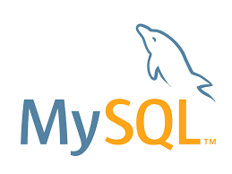
01
Tools Used: Flask MySQL

Slide 4
What is Flask?
02
Flask is a web framework that allows developers to build lightweight web applications quickly and easily with Flask Libraries. It was developed by Armin Ronacher, leader of the International Group of Python Enthusiasts(POCCO). It is basically based on the WSGI toolkit and Jinja2 templating engine.
Modern web frameworks use the routing technique to help a user remember application URLs. It is useful to access the desired page directly without having to navigate from the home page.

Slide 5
What is MySQL?
03
SQL is the standard language for dealing with Relational Databases.
SQL is used to insert, search, update, and delete database records.
Some of The Most Important SQL Commands
SELECT - extracts data from a database UPDATE - updates data in a database
DELETE - deletes data from a database INSERT INTO - inserts new data into a database
CREATE DATABASE - creates a new database ALTER DATABASE - modifies a database
CREATE TABLE - creates a new table ALTER TABLE - modifies a table
DROP TABLE - deletes a table

Slide 6
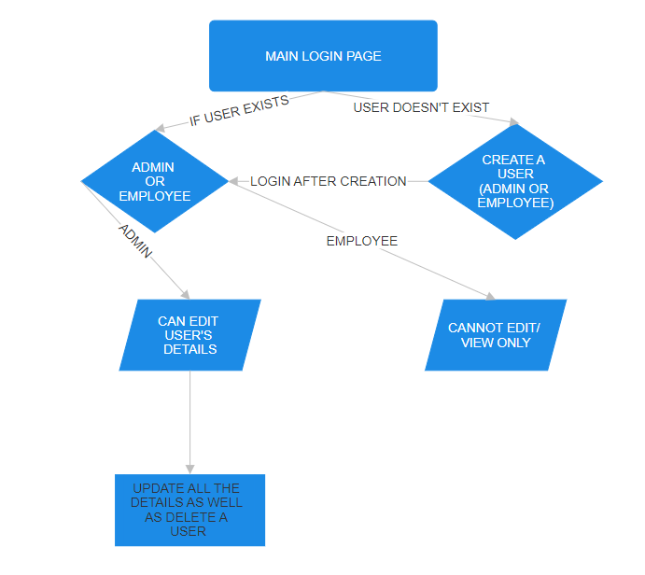
04 PROJECT STRUCTURE

Slide 7
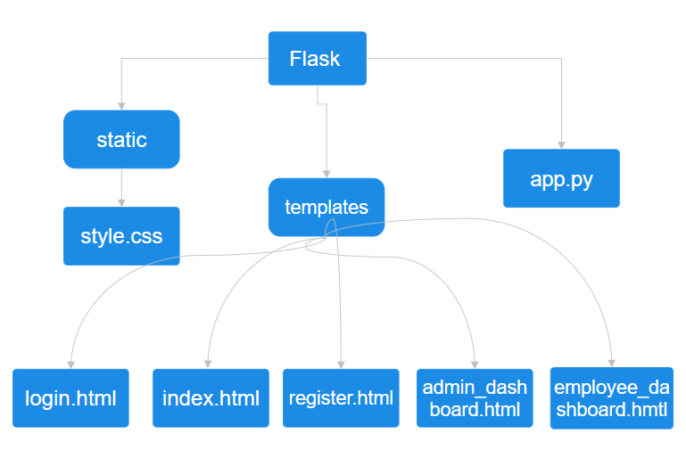
05 FLASK Structure

Slide 8
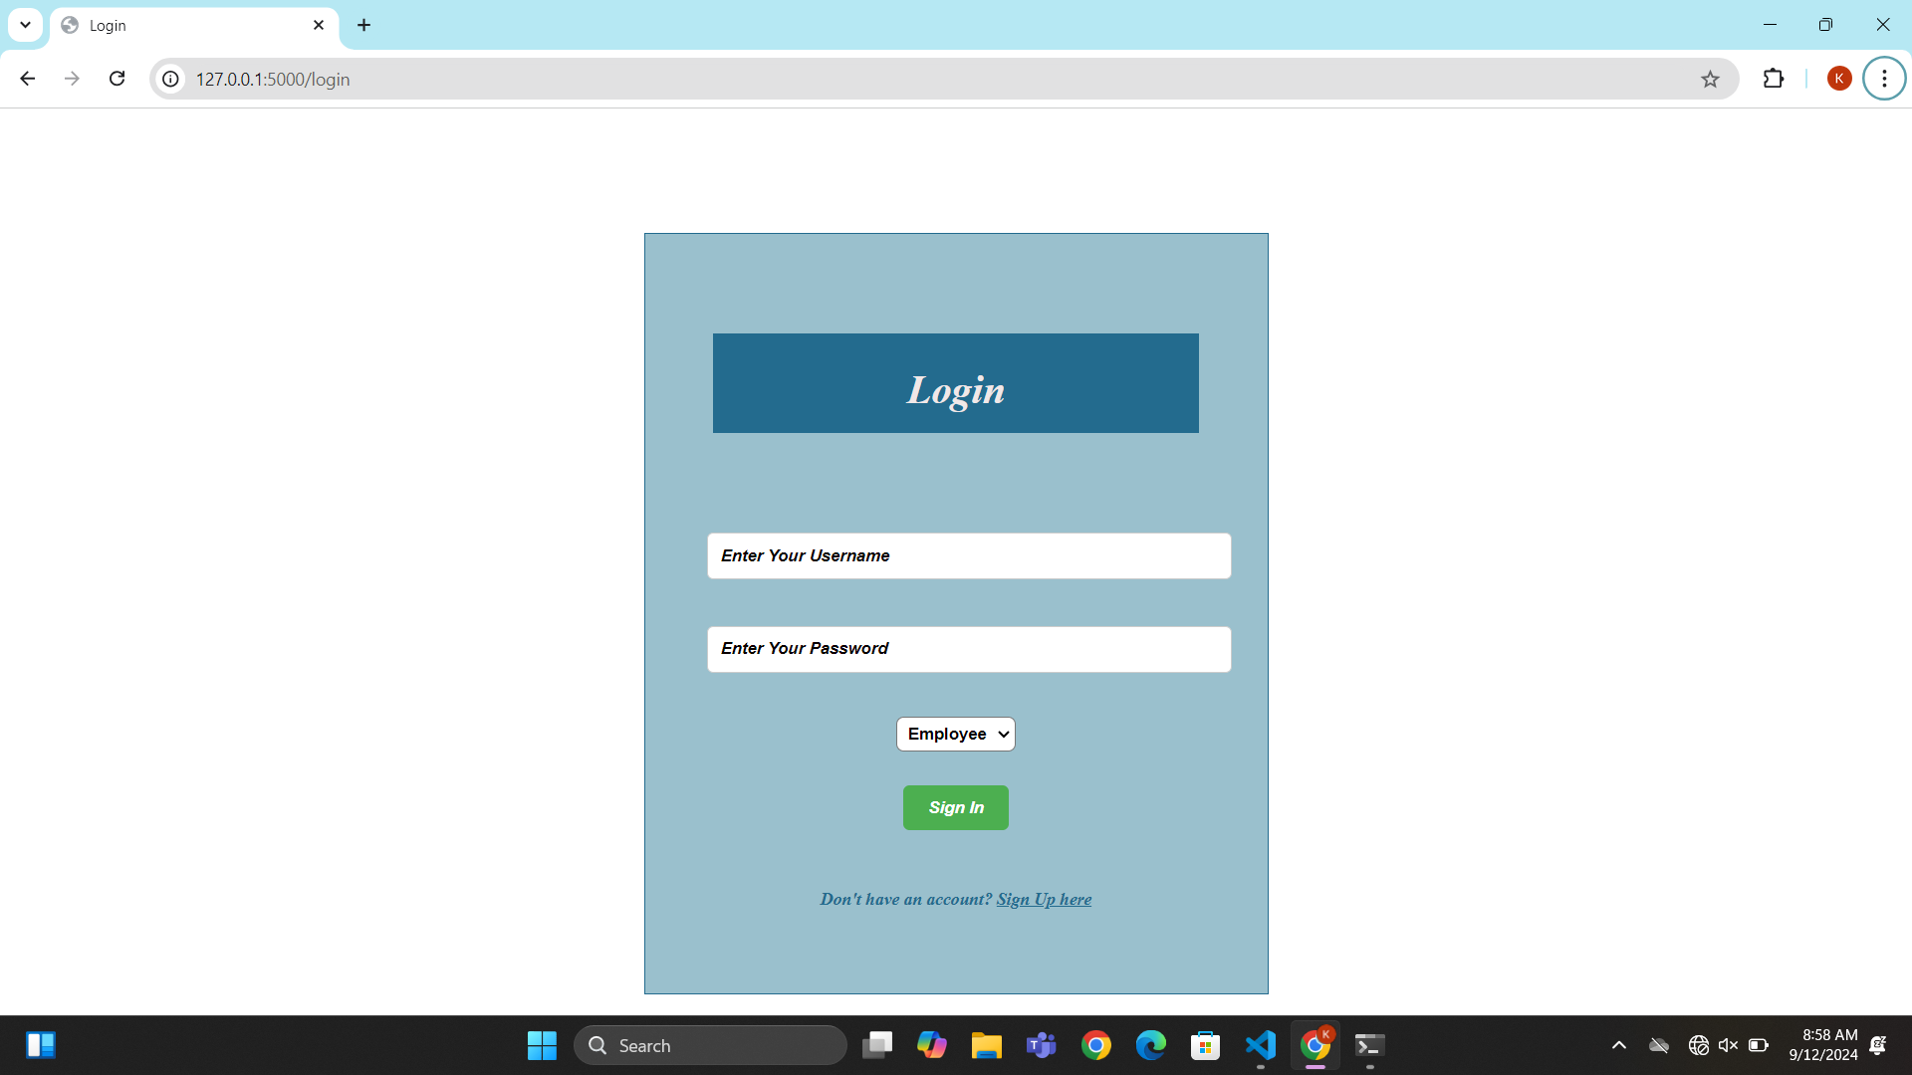
OUTPUTS – Login Page

Slide 9
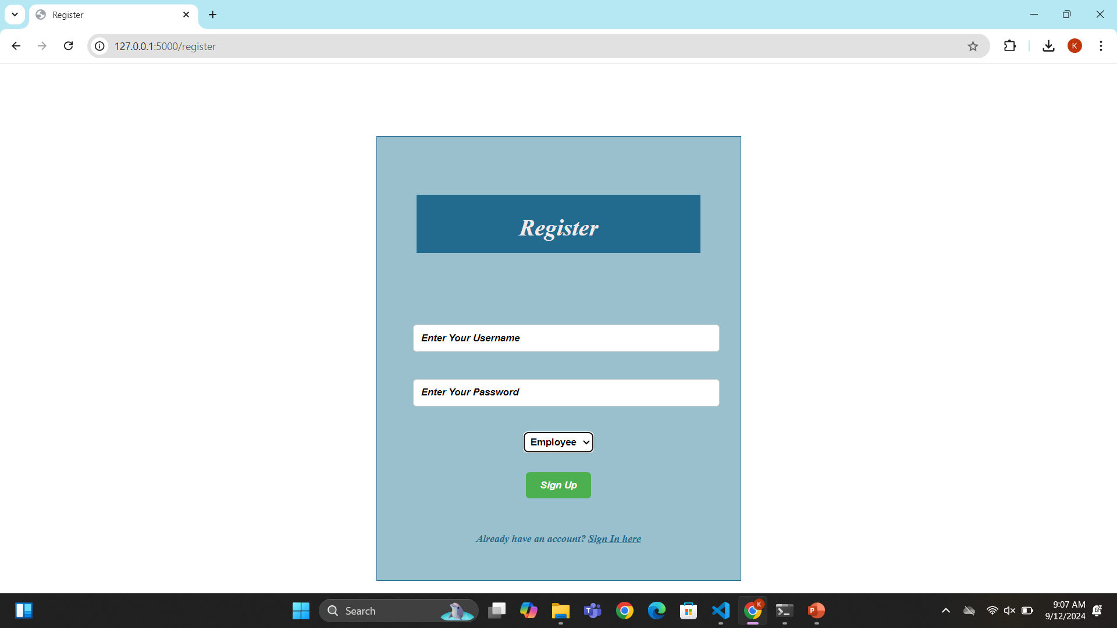
OUTPUTS – Register Page

Slide 10
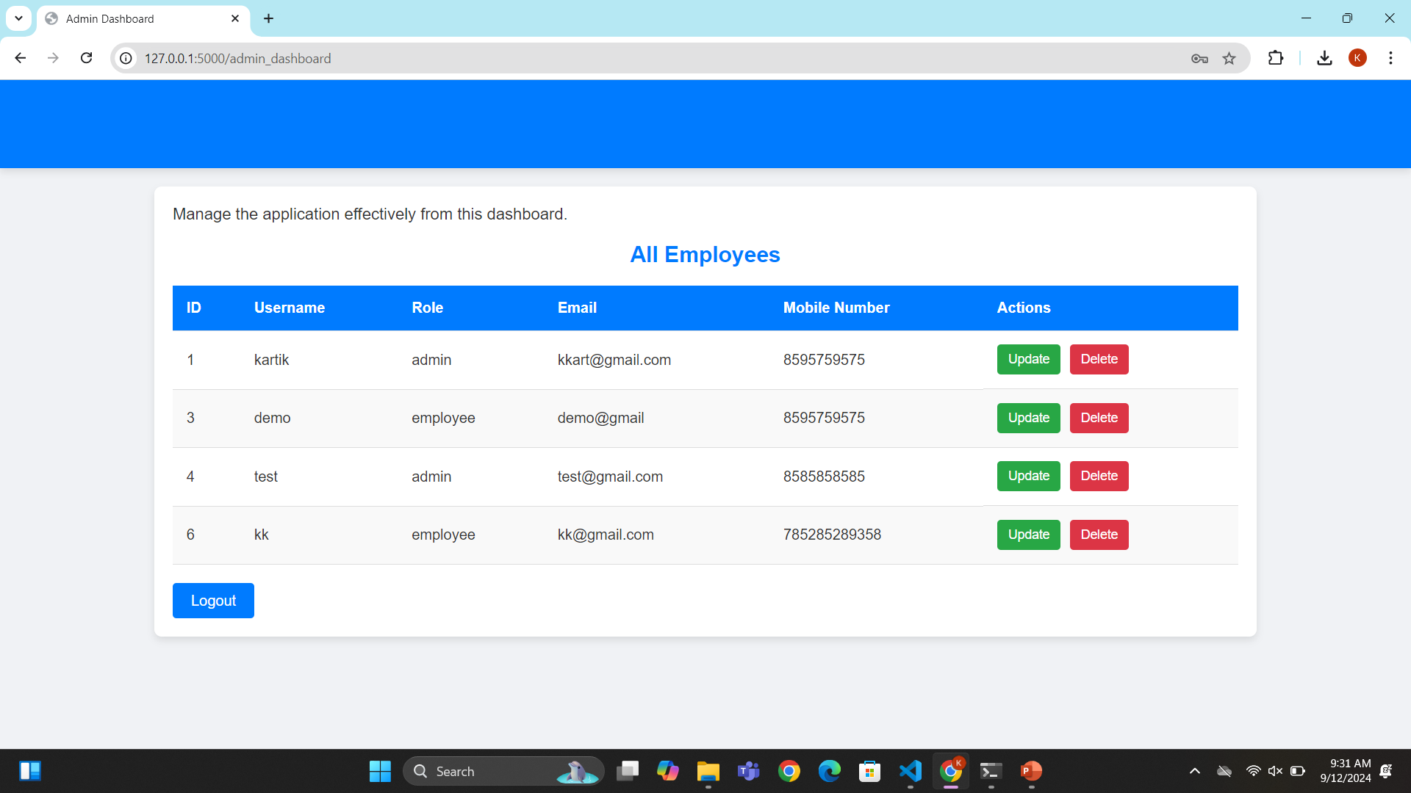
OUTPUTS – Admin Dashboard

Slide 11
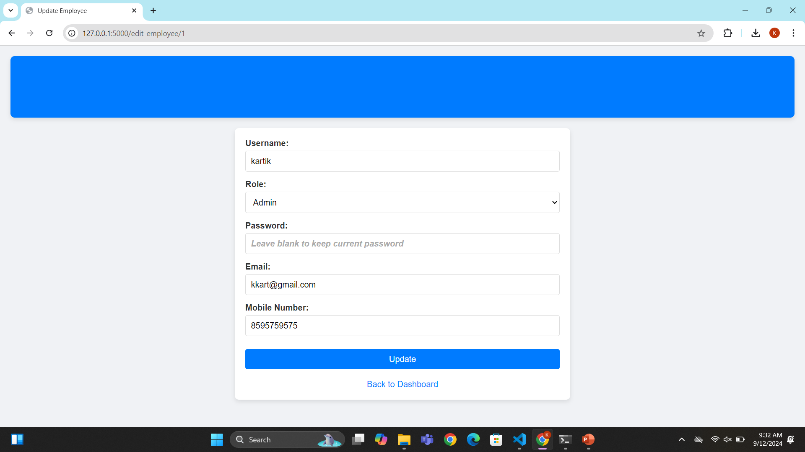
OUTPUTS – Update Employee

Slide 12
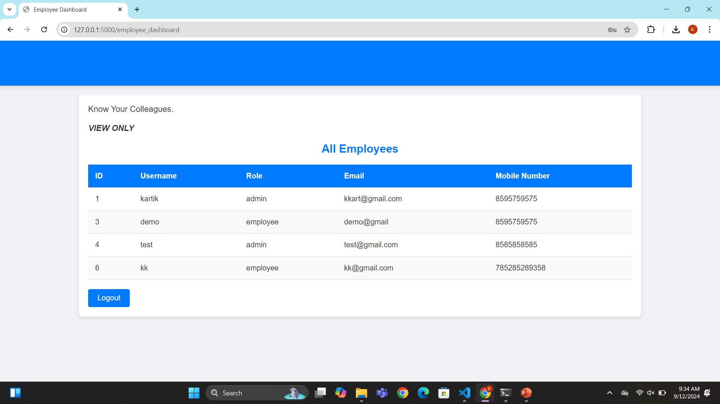
OUTPUTS – Employee Dashboard

Slide 13
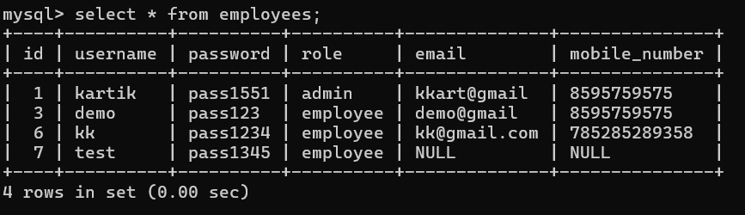
OUTPUTS – Database

Slide 14
Thank You

